Slide 1
DEPARTMENT OF CSE
COURSE NAME: ADAPTIVE Software
Engineering
COURSE CODE: 22CI2001
Topic:
Software ReVERSE engineering

Slide 2
AIM OF THE SESSION
To familiarize students with the basic concept of Software Reverse Engineering
INSTRUCTIONAL OBJECTIVES
This Session is designed to:
Define Software Re- Engineering & Reverse engineering
Describe the steps of Software Reverse Engineering
List out the differences between Forward and Reverse engineering
LEARNING OUTCOMES
At the end of this session, you should be able to:
Define Re-Engineering and Reverse engineering
Describe the steps of Software Reverse Engineering

Slide 3
AGENDA
Definition of Software Re-Engineering and Reverse Engineering
The need of software Re-engineering and Reverse Engineering
Steps of Software Reverse Engineering
Reverse Engineering Tools
Difference between Forward Engineering and Reverse Engineering
Benefits of Reverse Engineering
Where Reverse Engineering is used

Slide 4
Software Re-engineering
Software Re-engineering is a process of software development which is done to improve the maintainability of a software system.
When we need to update the software to keep it to the current market, without impacting its functionality, it is called software re-engineering. It is a thorough process where the design of software is changed and programs are re-written.
Legacy software cannot keep tuning with the latest technology available in the market. As the hardware become obsolete, updating of software becomes a headache. Even if software grows old with time, its functionality does not.
For example, initially Unix was developed in assembly language. When language C came into existence, Unix was re-engineered in C, because working in assembly language was difficult.

Slide 5
The need of software Re-engineering
Software re-engineering is an economical process for software development and quality enhancement of the product.
This process enables us to identify the useless consumption of deployed resources and the constraints that are restricting the development process so that the development process could be made easier and cost-effective (time, financial, direct advantage, optimize the code, indirect benefits, etc.) and maintainable.

Slide 6
The need of software Re-engineering (Cont..)
a) Boost up productivity: Software reengineering increase productivity by optimizing the code and database so that processing gets faster.
b) Processes in continuity: The functionality of older software product can be still used while the testing or development of software.
c) Improvement opportunity: Meanwhile the process of software reengineering, not only software qualities, features and functionality but also your skills are refined, new ideas hit in your mind. This makes the developers mind accustomed to capturing new opportunities so that more and more new features can be developed.
d) Reduction in risks: Instead of developing the software product from scratch or from the beginning stage here developers develop the product from its existing stage to enhance some specific features that are brought in concern by stakeholders or its users. Such kind of practice reduces the chances of fault fallibility.

Slide 7
The need of software Re-engineering (cont…)
e) Saves time: As we stated above here that the product is developed from the existing stage rather than the beginning stage so the time consumes in software engineering is lesser.
f) Optimization: This process refines the system features, functionalities and reduces the complexity of the product by consistent optimization as maximum as possible.

Slide 8
Re-Engineering cost factors:
The quality of the software to be re-engineered.
The tool support availability for engineering.
The extent of the data conversion which is required.
The availability of expert staff for Re-engineering.

Slide 9
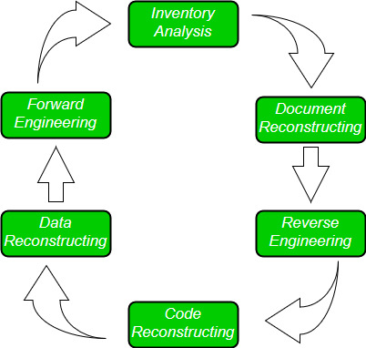
Software Re-Engineering Activities:

Slide 10
Software Re-Engineering Activities: (Cont…)
1. Inventory Analysis:
Every software organization should have an inventory of all the applications.
Inventory can be nothing more than a spreadsheet model containing information that provides a detailed description of every active application.
By sorting this information according to business criticality, longevity, current maintainability and other local important criteria, candidates for re-engineering appear.
The resource can then be allocated to a candidate application for re-engineering work.

Slide 11
Software Re-Engineering Activities: (Cont…)
2. Document reconstructing:
Documentation of a system either explains how it operates or how to use it.
Documentation must be updated.
It may not be necessary to fully document an application.
The system is business-critical and must be fully re-documented.

Slide 12
Software Re-Engineering Activities: (Cont…)
3. Reverse Engineering:
Reverse engineering is a process of design recovery. Reverse engineering tools extract data, architectural and procedural design information from an existing program.

Slide 13
Software Re-Engineering Activities: (Cont…)
4. Code Reconstructing:
To accomplish code reconstruction, the source code is analyzed using a reconstructing tool. Violations of structured programming construct are noted and code is then reconstructed.
The resultant restructured code is reviewed and tested to ensure that no anomalies have been introduced.

Slide 14
Software Re-Engineering Activities: (Cont…)
5. Data Restructuring:
Data restructuring begins with a reverse engineering activity.
Current data architecture is dissected, and the necessary data models are defined.
Data objects and attributes are identified, and existing data structure are reviewed for quality.

Slide 15
Software Re-Engineering Activities: (Cont…)
6. Forward Engineering:
Forward Engineering also called as renovation or reclamation not only for recovers design information from existing software but uses this information to alter or reconstitute the existing system in an effort to improve its overall quality.

Slide 16
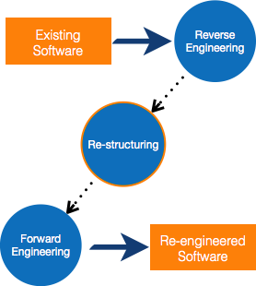
Software Re-engineering Cont…
Other than this, sometimes programmers notice that few parts of software need more maintenance than others and they also need re-engineering.

Slide 17
Reverse Engineering - Definition
It is a process to achieve system specification by thoroughly analyzing, understanding the existing system. This process can be seen as reverse SDLC model.

Slide 18
Reverse Engineering
Software Reverse Engineering is a process of recovering the design, requirement specifications and functions of a product from an analysis of its code. It builds a program database and generates information from this.
The purpose of reverse engineering is to facilitate the maintenance work by improving the understandability of a system and to produce the necessary documents for a legacy system.

Slide 19
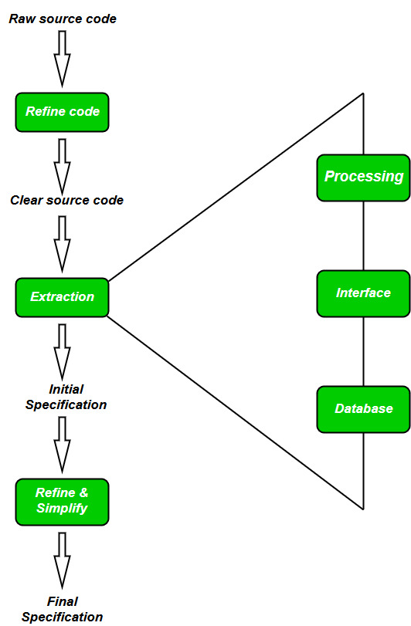
Steps of Software Reverse Engineering

Slide 20
Steps of Software Reverse Engineering (Cont..):
Collection Information: This step focuses on collecting all possible information (i.e., source design documents etc.) about the software.
Examining the information: The information collected in step-1 as studied so as to get familiar with the system.
Extracting the structure: This step concerns with identification of program structure in the form of structure chart where each node corresponds to some routine.

Slide 21
Steps of Software Reverse Engineering: (Cont..)
Recording the functionality: During this step processing details of each module of the structure, charts are recorded using structured language like decision table, etc.
5. Recording data flow: From the information extracted in step-3 and step-4, set of data flow diagrams are derived to show the flow of data among the processes.
6 Recording control flow: High level control structure of the software is recorded.

Slide 22
Steps of Software Reverse Engineering: (Cont…)
Review extracted design: Design document extracted is reviewed several times to ensure consistency and correctness. It also ensures that the design represents the program.
8. Generate documentation: Finally, in this step, the complete documentation including SRS, design document, history, overview, etc. are recorded for future use.

Slide 23
Reverse Engineering Tools:
Reverse engineering if done manually would consume lot of time and human labour and hence must be supported by automated tools. Some of tools are given below:
CIAO and CIA: A graphical navigator for software and web repositories along with a collection of Reverse Engineering tools.
Rigi: A visual software understanding tool.
Bunch: A software clustering/modularization tool.
GEN++: An application generator to support development of analysis tools for the C++ language.
PBS: (Portable Book Shelf) Software Bookshelf tools for extracting and visualizing the architecture of programs.

Slide 24
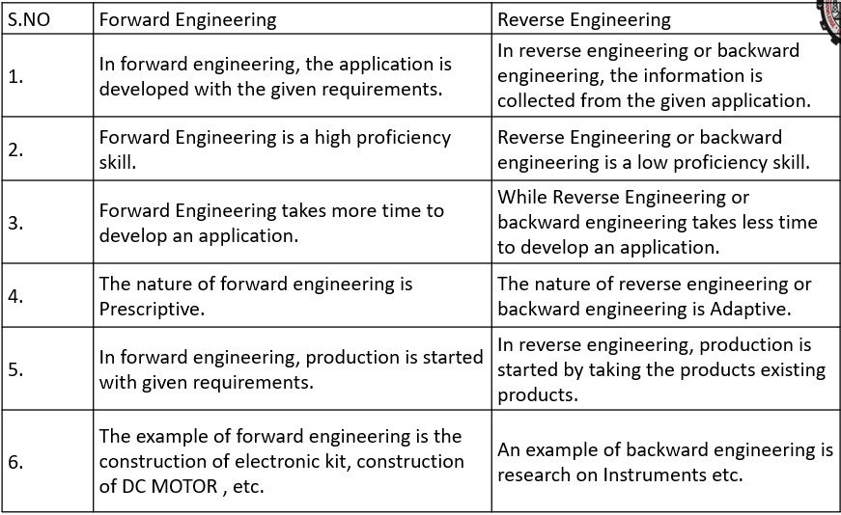
Difference between Forward Engineering and Reverse Engineering

Slide 25
Benefits of Reverse Engineering
Exploring existing designs and maneuvers. ...
Reconstructing a product that is outdated. ...
Discovering any product vulnerabilities. ...
Bringing less expensive & more efficient products to the market. ...
Creating a reliable CAD model for future reference.
Inspiring creative minds with old ideas

Slide 26
Where is reverse engineering used? (cont…)
Aerospace industry
The aerospace industry uses this technique for:
developing maintenance parts of an aircraft
adding, enhancing and fixing aircraft components
conducting aerodynamic analysis
manufacturing of tools

Slide 27
SELF-ASSESSMENT QUESTIONS
Need of Reengineering and Reverse engineering
Purpose of Inventory Analysis.
How Forward Engineering work.
Advantage of Code Restructuring.

Slide 28
REFERENCES FOR FURTHER LEARNING OF THE SESSION
TEXTBOOKS:
1. Roger S.Pressman, “Software Engineering – A Practitioner’s Approach” 7th Edition, Mc Graw Hill,(2014).
2. Ian Sommerville, “Software Engineering”, Tenth Edition, Pearson Education, (2015).
3. Agile Software Development Ecosystems, Jim Highsmith, Addison Wesley; ISBN: 0201760436; 1st edition
Reference Book
Agile Modelling: Effective Practices for Extreme Programming and the Unified Process Scott Amber John Wiley & Sons; ISBN: 0471202827; 1st edition.
WEB REFERNCES/MOOCS:
https://www.digite.com/kanban/what-is-kanban/
http://www.scaledagileframework.com
https://www.guru99.com/test-driven-development.html
https://junit.org/junit5/

Slide 29

THANK YOU
Team – ADAPTIVE SOFTWARE ENGINEERING

